Slide 1
ST1510 Programming for Data Analytics CA1
Name: Kong Cheng Sheng
Research Question: How do yearly salaries vary based on experience level, work type, and location?

Slide 2
Project Overview
Analyzed job posting datasets
Investigated salary trends
Compared salaries across
Experienced levels
Work types
Locations

Slide 3
Summary of Analysis Steps
1. Loaded and explored datasets 2. Removed irrelevant columns 3. Merged datasets using job_id 4. Cleaned salary data 5. Filtered yearly salaries only 6. Performed Pandas analysis 7. Created visualizations using Matplotlib 8. Identified salary trends and insights

Slide 4
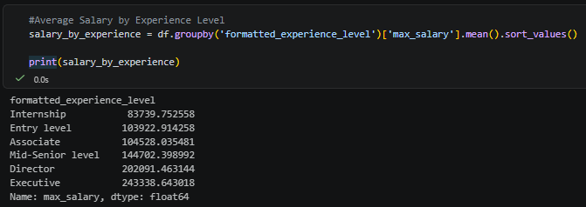
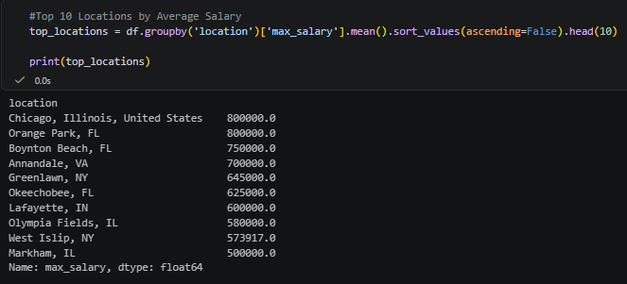
Pandas Analysis
Used groupby()
Salary by experience level
Higher experience levels generally receive higher yearly salaries.
Salary by location
Certain locations consistently offer significantly higher salaries.

Slide 5
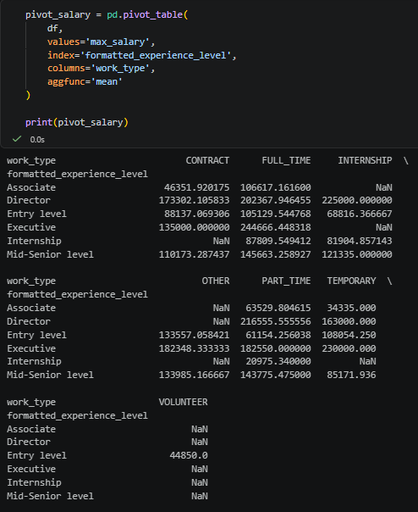
Pandas Analysis
Used pivot_table()
Compare salaries across both experience levels and work types simultaneously.

Slide 6
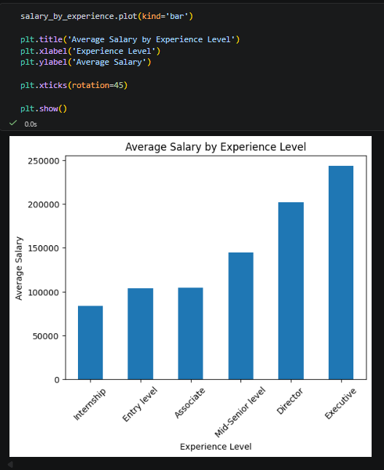
Matplotlib Analysis
Bar chart compares average yearly salaries across experience levels
Internship roles have the lowest average salaries
Director and Executive positions receive significantly higher salaries
Salary generally increases with experience and seniority

Slide 7
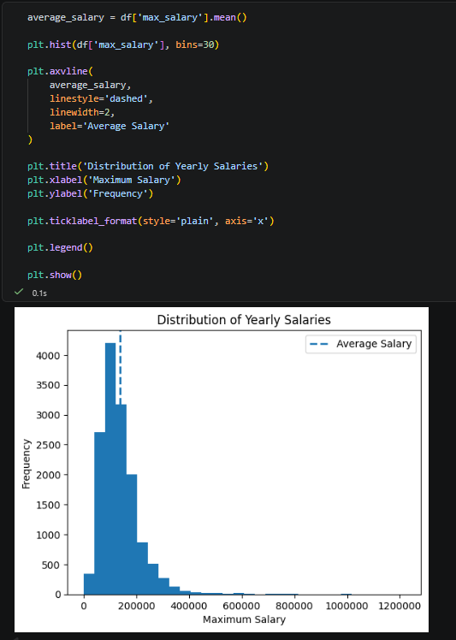
Matplotlib Analysis
Histogram shows the distribution of yearly salaries
Most salaries are concentrated within lower to middle salary ranges
Only a small number of jobs offer extremely high salaries
Added average salary reference line using axvline()

Slide 8
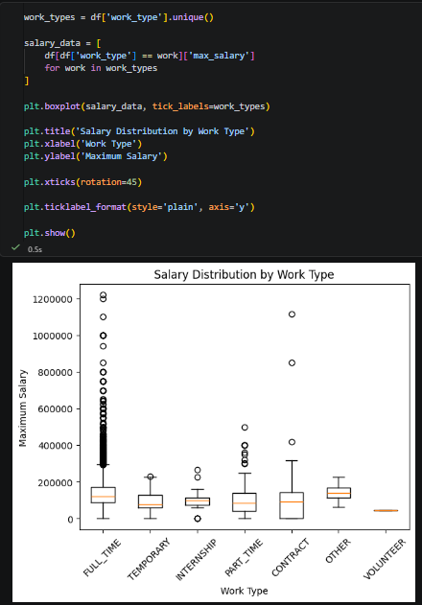
Matplotlib Analysis
Boxplot compares salary distributions across work types
FULL_TIME roles show the widest salary range
CONTRACT jobs contain several high-paying outliers
PART_TIME and TEMPORARY jobs generally have lower median salaries

Slide 9
Key Insights from Data Analysis
Higher experience levels generally receive higher yearly salaries
Director and Executive positions earn significantly more than Internship and Entry-level roles
FULL_TIME jobs dominate the dataset and show the widest salary range
Most jobs offer salaries within the lower to middle salary ranges
A small number of extremely high-paying jobs increase the overall average salary
Geographic location significantly affects salary levels

